Slide 1
Introduction to GIT

Slide 2
What is Git (SDLC)?
GIT is a Distributed Version Control System(DVCS)
Users create local copies of the work
A Distributed Repository allows
Users to modify files offline
Commit changes quickly
Every user to have a backup of the work
Notes:
There are several different approaches to software development, much like the various views of political parties toward governing a country. Some take a more structured, engineering-based approach to developing business solutions, whereas others may take a more incremental approach, where software evolves as it is developed piece-by-piece. Most methodologies share some combination of the following stages of software development:
Analysing the problem
Market research
Gathering requirements for the proposed business solution
Devising a plan or design for the software-based solution
Implementation (coding) of the software
Testing the software
Deployment
Maintenance and bug fixing
These stages are often referred to collectively as the software development lifecycle, or SDLC.

Slide 3
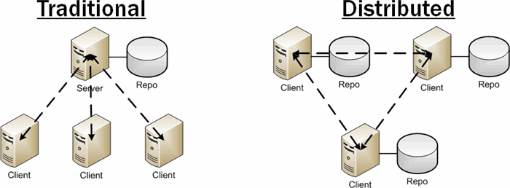
Central Repository VS Distributed Repository

Slide 4
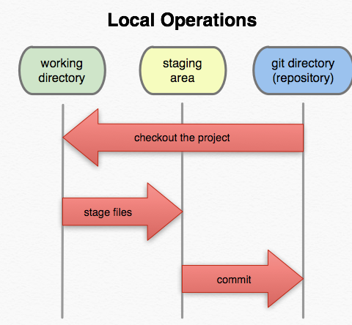
How Git works

Slide 5
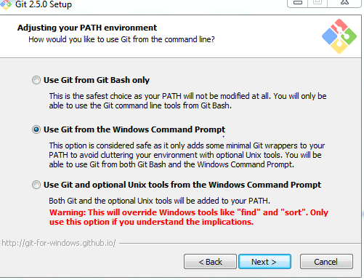
Getting started
Download GIT at https://git-scm.com/
Follow the basic installations with one modification
Notes:
Methodology affects the approaches, as it guides how the activities interact. E.g. if waterfall is used and there are handovers between phases and teams, hardened artifacts tend to be used.

Slide 6
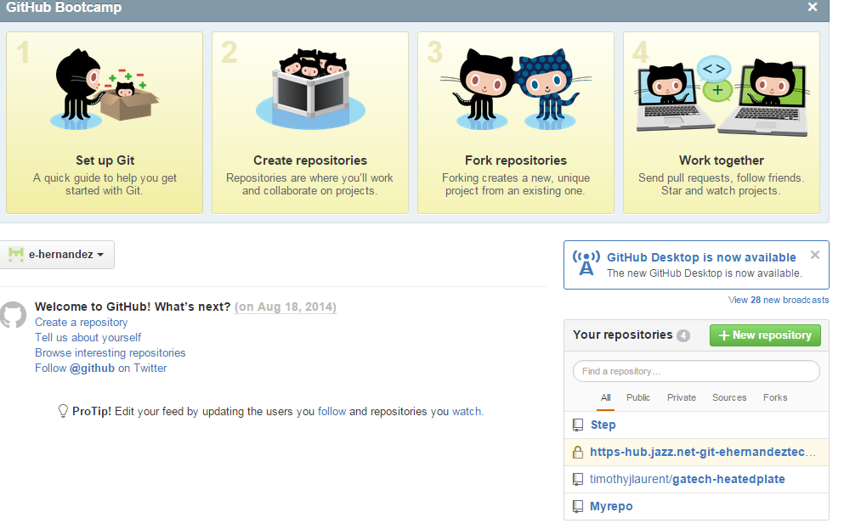
Git Hub
We will also signup for a free account on Github in order to get some public repositories.
Go to https://github.com/ and register for a free account
Once you are done you should click on “+ new repository”

Slide 7
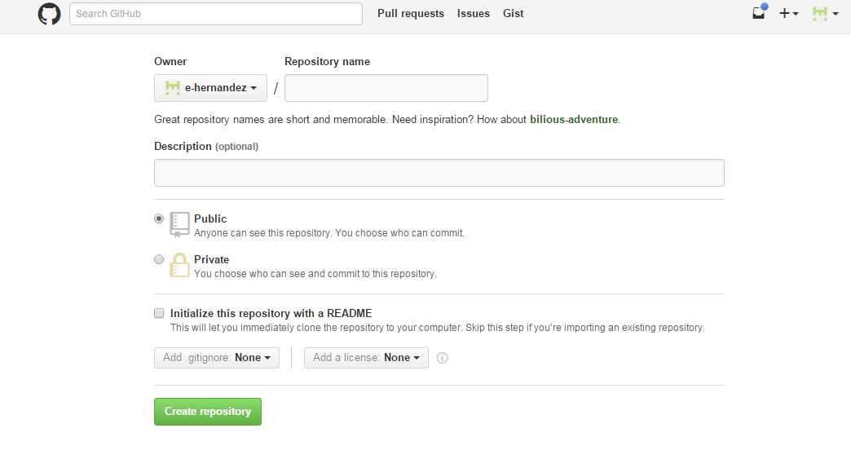
Git Hub
We will create a public repository- you may call it whatever you wish.

Slide 8
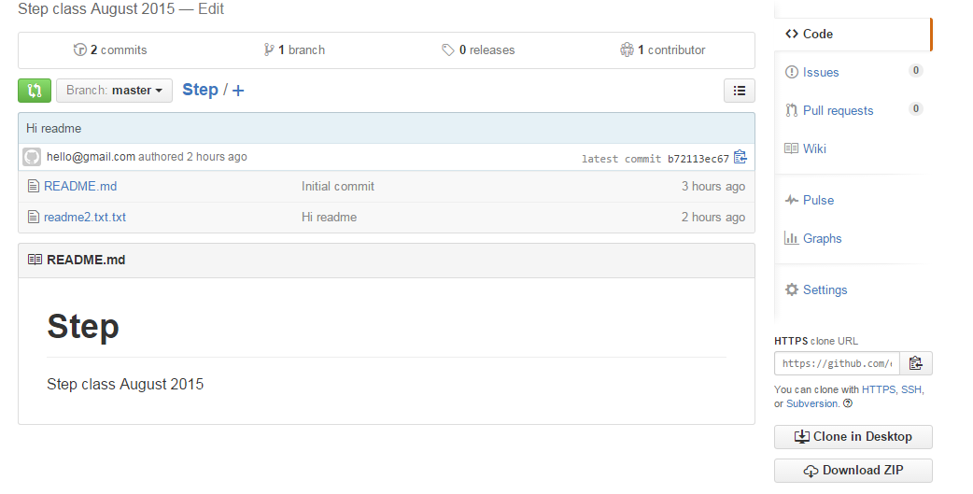
GitHub
After creating your repo on the right side of the screen you should see your newly created repository
Click on it and you will get to your main screen-for now just notice the clone repo link on the right side of the screen-you will copy this URL in order to link to your repo.

Slide 9
Git
For now minimize Git Hub and lets return to the command prompt.

Slide 10
Getting Started with Git
First create a directory on your hard drive which you will use as your repository
I created the directory Repo
The path is c:/Repo/
Now type in Git into the run dialog in windows you should see git bash come up
Run git bash
Navigate to the directory you created
Windows command line TIPS
CD .. Brings your focus back on directory
CD repo Changes the directory to repo(Or what ever you named your directory.

Slide 11
Getting Started with Git
Once you are in the directory you want to work in do the following
Git init This initializes an empty git repository in the directory
Git config user.name “ Your Name “
Git config user.email Youremail@whoever.com
Git clone https://This is where I clone my repo from
These first steps initialized your git repo along with identifying you to git. You also cloned the repository you created on git hub.

Slide 12
Some more basics
Lets view the directory structure by using either the LS or DIR command
You should a directory with the name of your repository.
Lets navigate to the directory in my case
Cd Step
Dir
I notice there is a read me file.
I want to edit it so I will use the command
Vim readme.txt

Slide 13
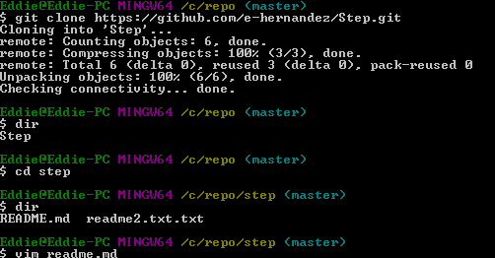
My print out

Slide 14
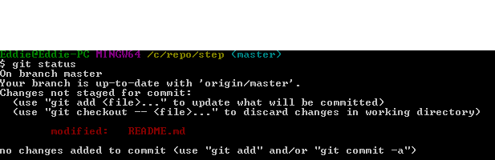
Git Basics Continued
Vim opens the text editor
Press the I key to begin typing
When you are done press ESC followed by
:WQ then press the enter key
Now lets type the command Git Status
You will notice that the Readme.md file is red
That is because it is an untracked file that was modified
We need to tell GIT that we want this file to be monitored for changes
Lets type Git Add Readme.md-

Slide 15
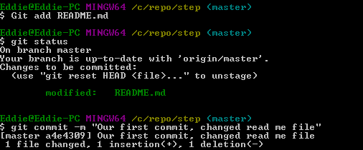
Git cOntinued
Notice that README.md turned green. This mean the file is in our staging area. We then use the command
Git commit –m “Some description of what we just changed”
Notice the log file underneath the commit.

Slide 16
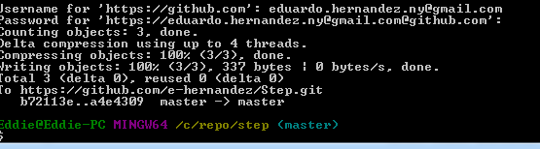
Git Basics Continued
Now that we have this file ready to go, lets push it out to our remote Repo.
Type Git Push
You will have to enter your username followed by your password
After you push the change, go to Githib and see if the readmd has been modified.

Slide 17
Intermediate commands
One of the many advantage of git is to have a time capsule of the files you are working on. You may have noticed in the steps before the word (Master) with regards to our repo. That is because we are in the master branch. Every git repo begins with only the master branch. IT is very common for developers to create a new branch when they are trying to implement a new feature. When you create a new branch, the contents of the master branch are copied. Lets create some branches !!!
Git Checkout –b ANEwFeature
Observe the output on the next peage

Slide 18
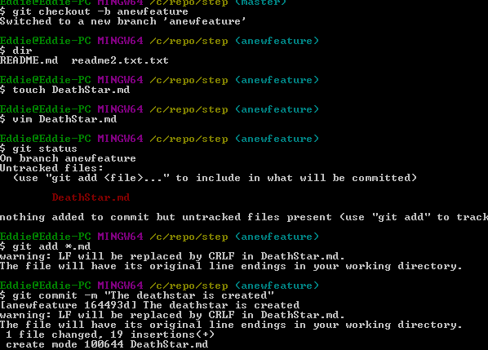
MY Output

Slide 19

Git commands
You may have noticed I used git add *.md
* IS A WILD CARD. In the way I used it GIT would have added all files that ended in MD. This is a shortcut for adding multiple files.
After created a branch it is good practice to type git branch. This will show us all the branches we have in our repo.

Slide 20
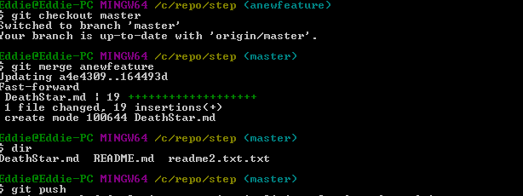
Merging branches
We are now going to return to master and merge our branches.

Slide 21

What did we Merge/push?
If we look at github or even GIT, we notice that deathstar.md now appears in the master branch. However the new branch we created is still only stored locally. In order to push the newly created branch we do the following
Git push --all origin
Go head and check the branches tab in Git Hub, you should see the anew feature branch,

Slide 22
Problems with merging
In our example we had no conflicts with merging. Conflicts can occur when two more people are working on the same file and they both change the same part of the file a conflict will occur. At this point before a merger is successful someone must look at the conflict and fix it. This is a much more advance topic

Slide 23
Glossary of common Git commands
Git init --------------------- Create a new Local git repository
Git clone /path/to/repository ---------- Clones a repo
git config --global user.name <name> ----- defines the author
git config - -Global user.email <email> ------ defines the email
Git add <file name> --------------- This tells git to track the file
Git add * ----- tells git to track all files created since the last commit
Git commit – m “Commit message” -----------Your file is now committed to what is called the HEAD(This is stored on your local repo). It is not yet in your shared or public repo.
Git push --all origin ----------------- pushes all branches
Git Pull ------------- will pull the latest repo from the server.
Git Checkout –b Somebranch -----This creates the branch somebranch

Slide 24
Your Assignment
Create a new git repo
Create a new md file nameinfo.md
On the first line put your first name
Add and commit
Create a new branch called details
Modify the info.md in the details branch by adding your email address to it
Switch back to your Master branch and merge the detail branch into it.
Push everything to the repo
Call the Instructor over and explain what you did

Slide 25
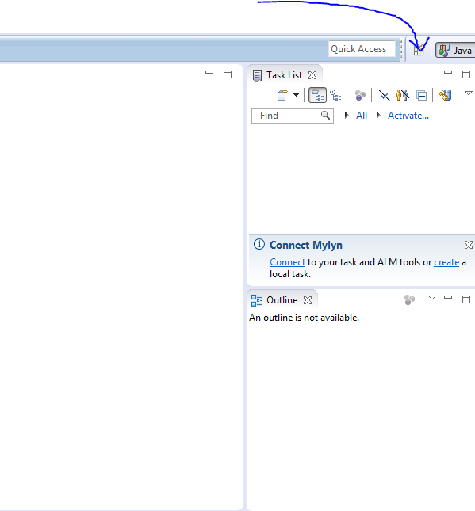
EGIT
There are many GUI environments that can help us with GIT. One of the tools we use as developers is Eclipse IDE. Eclipse has an add on called EGIT which can aid us as developers.
Lets get Started !!!
First run eclipse
Then click on the add perspective button on the top right of the screen

Slide 26
EGIT
There are many GUI environments that can help us with GIT. One of the tools we use as developers is Eclipse IDE. Eclipse has an add on called EGIT which can aid us as developers.
Lets get Started !!!
First run eclipse
Then click on the add perspective button on the top right of the screen

Slide 27
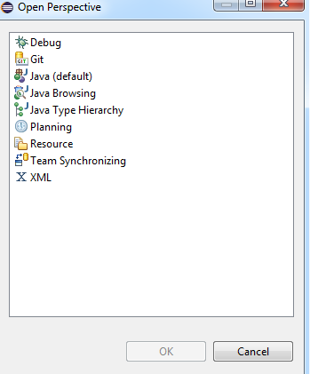
Egit
Select GIT and then click OK

Slide 28
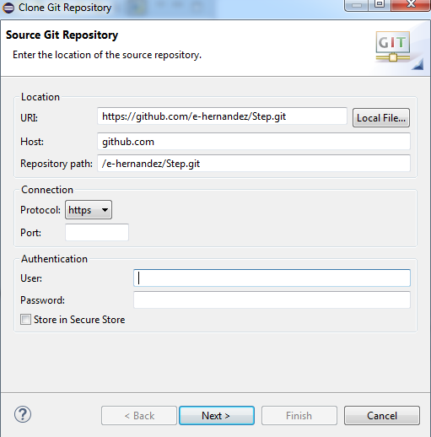
Egit
We will clone our previously created Repo
Copy the URL from your git hub repo-enter your username and password in order to be able to push updates

Slide 29
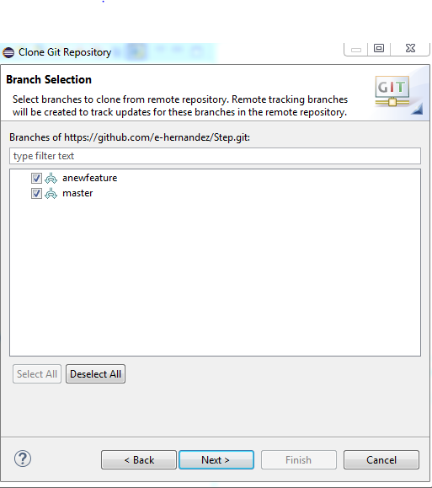
EGIT
You should see all of the branches from your remote repo

Slide 30
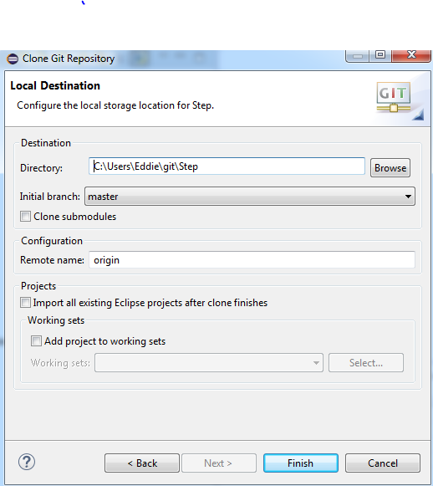
EGIT
You can select your local directory here.

Slide 31
EGIT and GITHub
In order to get your java projects, packages, and classes to work we need to make the working space the local repo.
Complete the following steps
First create a new project
Uncheck the use default location button
Enter the location of your local repo

Slide 32
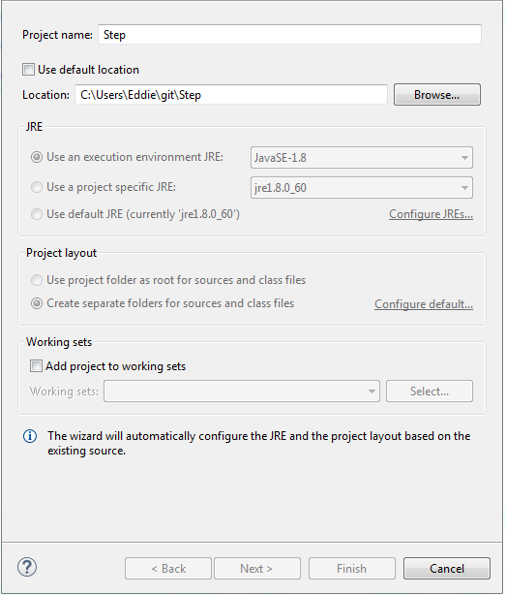
EGIP

Slide 33
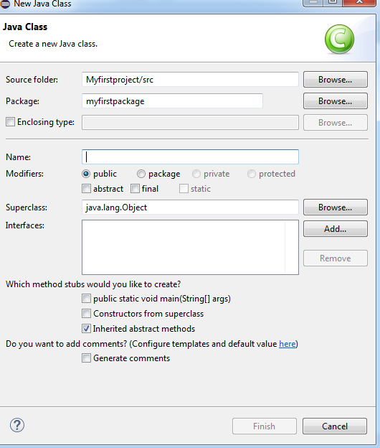
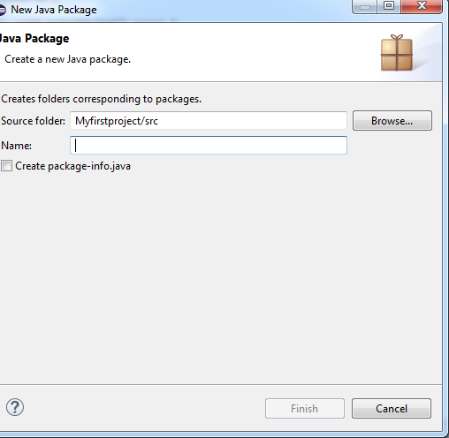
Create a package and a java class
Right click on your project and select new Java Package
Right click on the newly created Package and select new Class

Slide 34
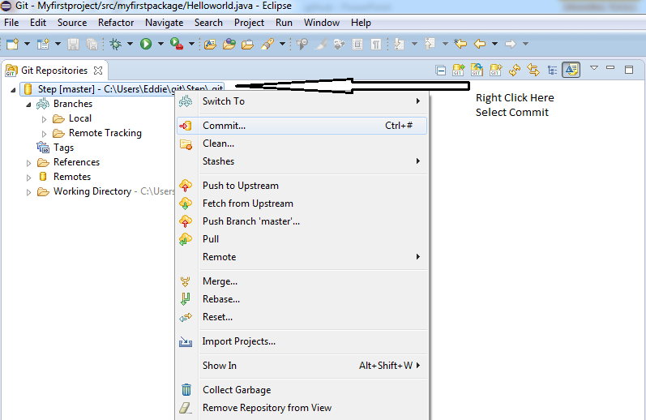
Lets add and commit our files
Lets switch into our git perspective.

Slide 35
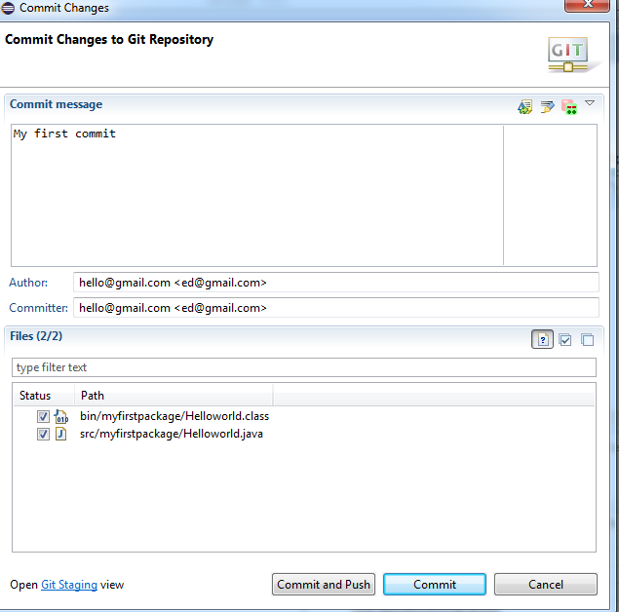
OUR FIRST COMMIT!!

Slide 36
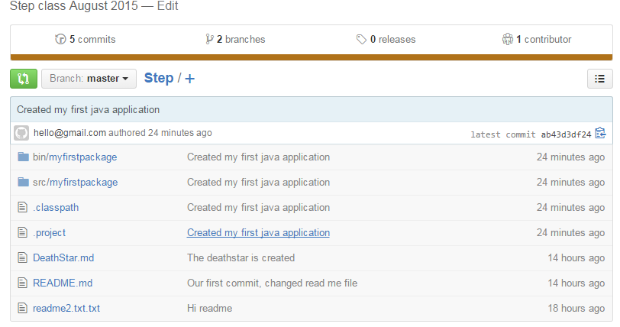
Continue to code
You can now code and commit your code whenever you need to.
If you look at git hub you will now see

Slide 37
Importing back from gIT on another PC
You can do this 2 ways
You can use GitBash and just clone your repo to a folder on your hard drive.
Use EGIT
I will now show the EGIT Method
Open the Egit Perspective
Select the option the lets you clone the repository
Enter the correct information

Slide 38
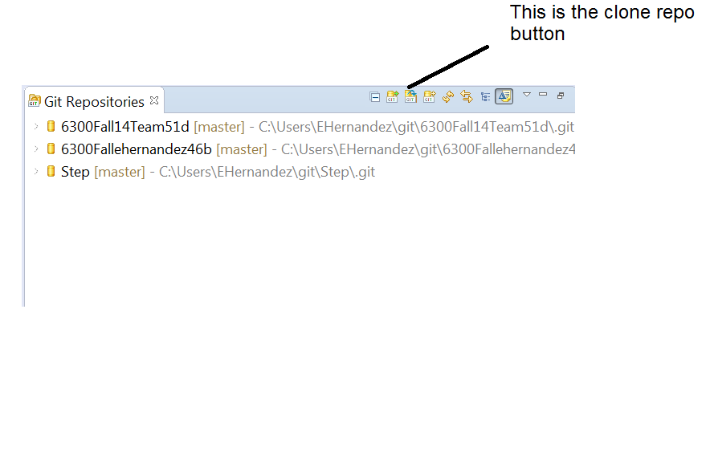
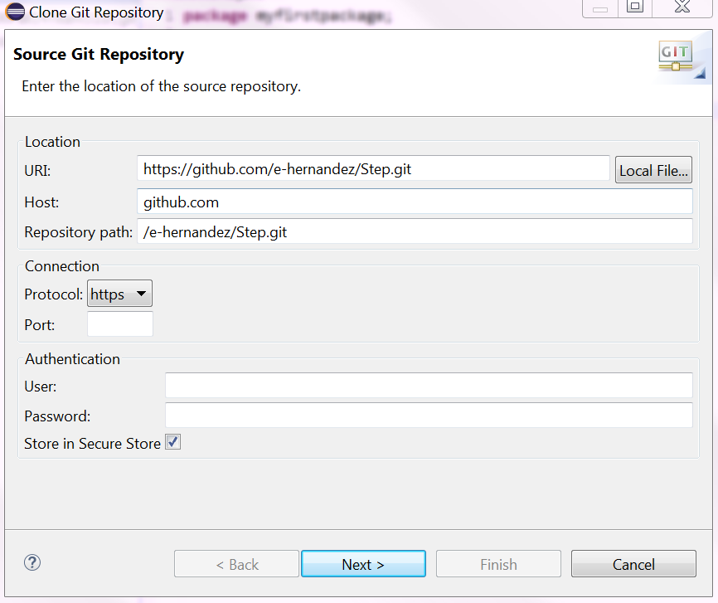
EGIT Continued
Once you clone the repository, fill in the corresponding information once more. Go into your GITHUB and find the link to your repo.

Slide 39
EGIT Continued
Normally that is all you need to do
You might have to add some libraries, depending on the environment your working on.
If for some reason you can’t see your project you might have to import it after you clone your repo.

Slide 40
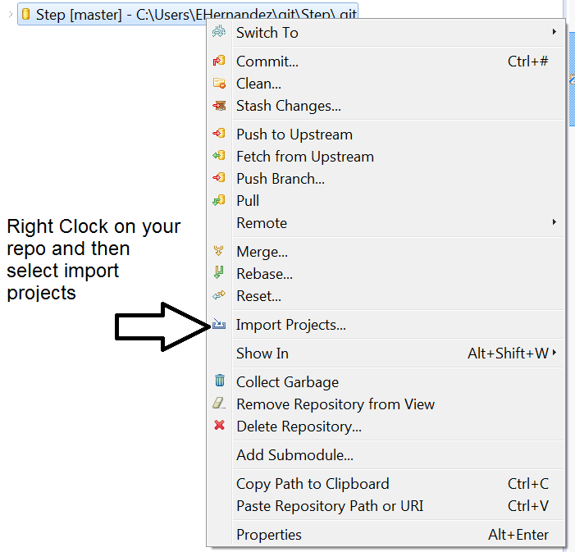
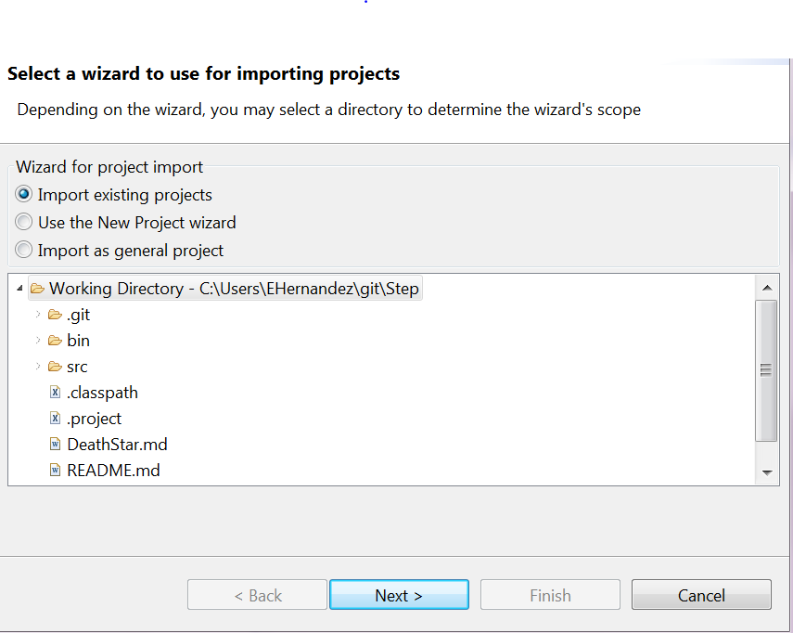
That’s IT

Slide 41
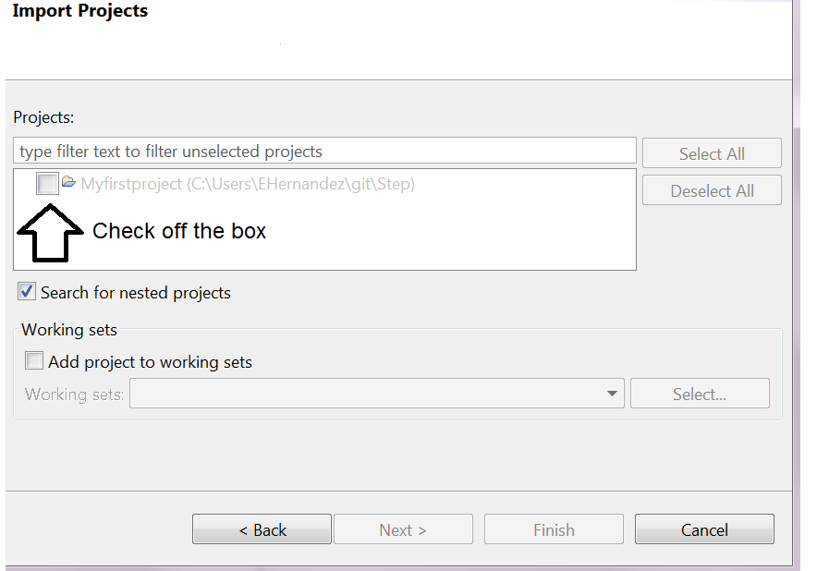
That’s IT I promise!

Slide 42
Final remarks
I encourage you to become a git master
Git allows you to have a portfolio of your work.
All of your files can be tracked documents, spreadsheets, code, test cases, etc.
Share the work you are most proud OF!!
All of the work you do in this class should be in git. This will allow you to reference it and share it as needed

Slide 43
Git Resources- PRO TIP- download the cheatsheet
http://readwrite.com/2013/09/30/understanding-github-a-journey-for-beginners-part-1
http://readwrite.com/2013/10/02/github-for-beginners-part-2
http://git-scm.com/book
http://www.codeschool.com/courses/try-git
http://www.youtube.com/GitHubGuides
http://gitref.org/
http://rogerdudler.github.io/git-guide
https://www.atlassian.com/dms/wac/images/landing/git/atlassian_git_cheatsheet.pdf

